Slide 1
Education policy and the state language: pre-school
VPP-LETONIKA-2022/1-0001
Prof., Dr. habil. philol. Dace Markus
Doc., Dr. paed. Agrita Tauriņa
Prof., Dr. psych. Tija Zīriņa
(Liepaja University)
15 June 2023, Vytautas Magnus University, Kaunas

Slide 2
Introduction
VPP-LETONIKA-2022/1-0001
Since 2018, our research team has been focusing on the learning of the national language of ethnic minority children in pre-school, so that language proficiency does not become a barrier to successful learning in 1st Grade. This research correlates with decisions in Latvian education policy.
See also in the journal “Sustainable Multilingualism” (2023) published article “Language Policy Implementation in Latvian Pre-school: Latvian Language Skills of Minority Children”:
“The Latvian language skills of minority children who attend pre-school education groups with a dominant Russian language on a daily basis are still insufficient and do not comply with the requirements set in Cabinet Regulation No. 716 of 2018 that the children should be prepared to start school with Latvian as the learning language or bilingually…”

Slide 3
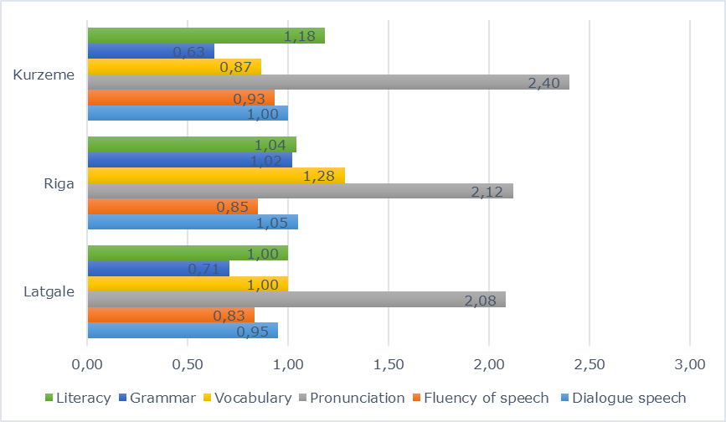
RESEARCH ON LATVIAN CHILDREN LANGUAGE
VPP-LETONIKA-2022/1-0001
Comparison of average Latvian language proficiency results of minority children in Russian language groups in 2020

Slide 4
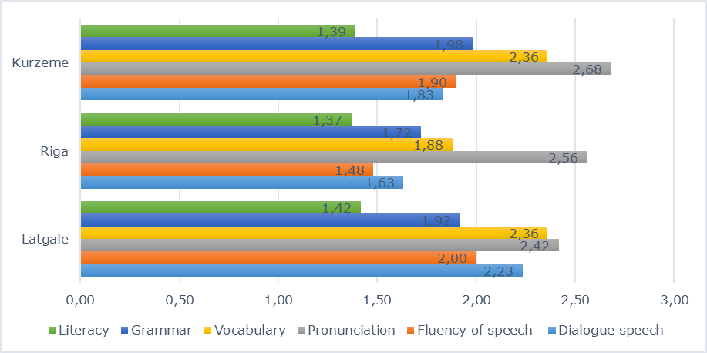
Comparison of average Latvian language proficiency results of minority children in Latvian language groups in 2020
VPP-LETONIKA-2022/1-0001

Slide 5
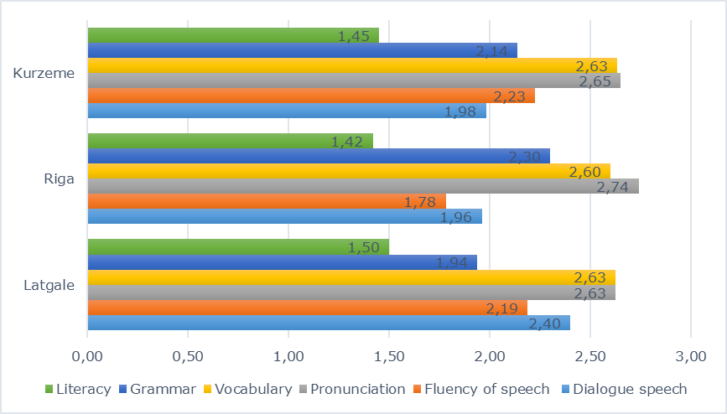
Comparison of average Latvian language proficiency results for children with Latvian as their mother tongue in 2020
VPP-LETONIKA-2022/1-0001

Slide 6
Skills and willingness
VPP-LETONIKA-2022/1-0001
5-6 year olds from ethnic minorities have acquired their mother tongue well.
The problem is learning the national language.
During the testing, several children showed interest in speaking Latvian. For example, I had a conversation with a Russian boy who did not speak Latvian at all.
After the test, I asked him in Russian:
“На каком языке ты говоришь с родителями?” (What language do you speak with your parents?)
Answer: “На русском” (In Russian).
“А на каком языке ты говоришь с дедушкой и с бабушкой (What language do you speak with your grandpa and grandma?).
“Тоже на русском” (Also in Russian). And he added: “Но с катенком Латэ я говорю по латышски!” (But I speak Latvian with the cat Late).

Slide 7
Changes in education policy and in the real life
VPP-LETONIKA-2022/1-0001
"According to the amended law, from 1 September 2023, education will be conducted only in the state language in pre-school education and primary education in grades 1, 4 and 7" (Amendments to the Education Law, 2022). The above-mentioned amendments to the Education Law (25.10.2022) stipulate that from 1 September 2023 Latvia will move to full Latvian-language education simultaneously in both pre-school groups and Grade 1.
There is an increasing tendency for ethnic minority parents to send their children to Latvian-language groups on a daily basis.
There are currently 96 educational institutions in Latvia where preschool children attend groups with Russian as their everyday language or with a combination of Latvian and Russian. In Vidzeme region - only 1 such kindergarten group, in Zemgale region- also 1,in Latgale region - 12, in Kurzeme region - 11, in Riga - 71.

Slide 8
A survey of pre-school teachers: results
VPP-LETONIKA-2022/1-0001
In May, we conducted an additional Latvian preschool teachers' express survey to ascertain both teachers' self-assessment of their language skills and their perceptions of minority children's readiness to learn in Latvian. All teachers of minority groups were asked to participate and the survey was completed by teachers from 32 groups of minority children.
In Vidzeme and Zemgale, groups of ethnic minority children are already making the transition to a full daily routine in Latvian. All pre-school teachers of 20 minority groups in Kurzeme, Latgale, and Riga indicated that children are partially prepared for studies in school in Latvian language.
Out of 5 groups (2 in Riga, 3 in Kurzeme) in which the teachers admitted that the children are completely unprepared for learning in Latvian, children in 2 groups participate in everyday life activities only in Russian, while in 3 groups Russian and Latvian are mixed, and the teachers admit that it is difficult for children to communicate in Latvian, so they often switch to Russian.
The teachers surveyed still taught children in Russian in 11 groups, in both languages in 14 groups, and in Latvian in 8 groups.

Slide 9
Results
VPP-LETONIKA-2022/1-0001
As the visual information in almost all groups of ethnic minority children is in Latvian or almost in Latvian (the lowest percentage in 1 Riga group, where 70% in Latvian and 30% in Russian), overall there was not much correlation between children's language proficiency and the language of visual information, but it was surprising to see one group where children are not prepared for learning in Latvian and the visual information is 100% in Russian.
Teachers point out that both the teachers' lessons and the language of everyday communication are very important and decisive for children to learn Latvian, especially if they come from minority families where Latvian is not spoken.
The survey also included a self-assessment question on how teachers rate their Latvian language skills on a 10-point scale. We will not analyze it at the moment. We are grateful for the honest answers, which we believe also convince us that the ongoing quality check of teachers' Latvian language is also necessary.

Slide 10
Acknowledgements
VPP-LETONIKA-2022/1-0001
Our research team is grateful to the National Research Programme “Letonika”-2022/1-0001 for the financial support.
We are grateful to the leaders of pre-school institutions for their valuable support in recording and surveying children's language and to parents for allowing us to test their children's language skills.

Slide 11
CONCLUSIONS (1)
VPP-LETONIKA-2022/1-0001
According to the education legislation, the transition to Latvian as the language of instruction from 1 September 2023 will take place both in pre-school age groups and in Grade 1.
Although decreasing the number of minority children who attend pre-school education groups with a dominant Russian language on a daily basis, based on the findings of the study, we recommend the use of teaching assistants in the first grades of schools for at least one year to help children who have graduated from minority pre-school groups to learn in Latvian.

Slide 12
CONCLUSIONS (2)
VPP-LETONIKA-2022/1-0001
Since minority children in pre-school age have mostly used their mother tongue and their families do not communicate in Latvian, special attention in pre-school age groups should be paid to the use of the Latvian language not only in learning activities, but also in everyday life in the pre-school institution, thus developing not only knowledge, but also skills in the use of the Latvian language.
It is very "sad", but we have to admit that in the transition to Latvian as the everyday language in all groups of minority children, we also support the Latvian language proficiency test for pre-school teachers.

Slide 13
CONCLUSIONS (3)
VPP-LETONIKA-2022/1-0001
In order for minority children of pre-school age to successfully learn Latvian in accordance with the legislation, it is not enough to have only a few Latvian language lessons a week, but it is necessary to create a Latvian language environment that may include communication, games, visual aids, etc. in daily pre-school education groups.
The results and recommendations have been presented to the specialists responsible for pre-school education in the Ministry of Education and Science.

Slide 14
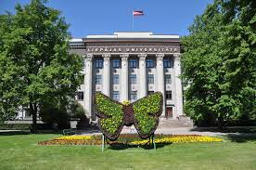
Thank you for your attention !
VPP-LETONIKA-2022/1-0001

Slide 15
The analysis
VPP-LETONIKA-2022/1-0001
The analysis was based on Tomme-Jukēvica’s (2018) development recommendations:
dialogue speech - understands instructions, answers questions, forms questions, starts a conversation, uses speech etiquette,
fluency of speech - speaks fluently, paraphrases, logically connects speech, pauses;
pronunciation - pronounces sounds accurately, uses emphasis correctly;
vocabulary - relevant to the topic, diverse, unnecessary to use another language;
grammar - uses correct grammatical forms, uses various sentence structures;
literacy - knows letters, reads syllables, words, and sentences

